Slide 1
Java Lecture 6

Slide 2
Java Basics
Arrays :
  These are used to store similar type of data.
  Concept of array arises due to need of large data storage of same type of data.
  Types of arrays:
    Single dimensional array.(1-D array)
    Double dimensional array.(2-D array)

Slide 3
Java Basics
Single Dimensional array
Index integer array array length=6
0 //4 byte
1 //4 byte
2 //4 byte
3 //4 byte
4 //4 byte
5 //4 byte

Slide 4
Java Basics
Single Dimensional array Declaration
  Syntax:
    data type var-name[];
    array-var=new data type[size];
  Example:
    int rollno[];
    rollno=new int[60];
Using new keyword all elements of array are initialized to 0.

Slide 5
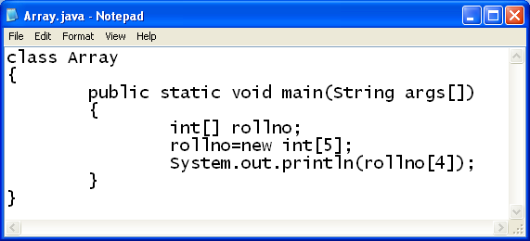
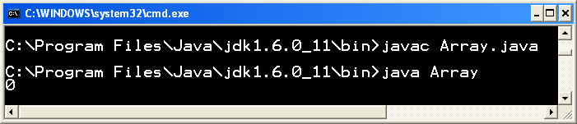
Java Basics
Single Dimensional array Example

Slide 6
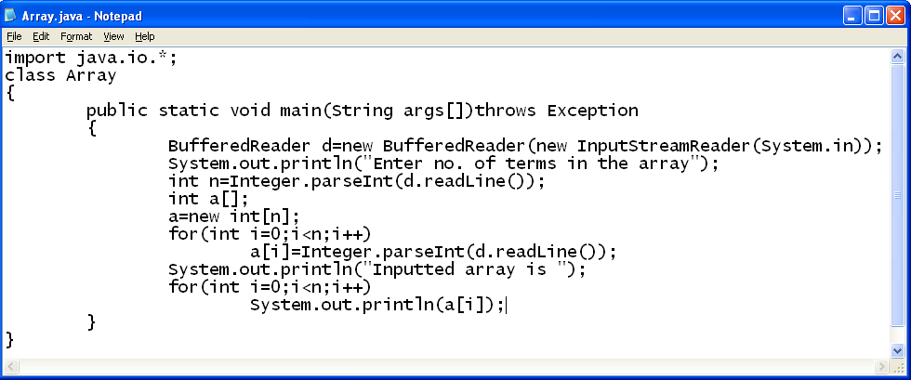
Java Basics
Single Dimensional array Input & Output

Slide 7
Java Basics
2-Dimensional Array
0 1 2 coulums
0
1
2
3
rows

Slide 8
Java Basics
Double Dimensional array Declaration
  Syntax:
    data type var-name[][];
    array-var=new data type[row][column];
  Example:
    int rollno[][];
    rollno=new int[6][3];

Slide 9
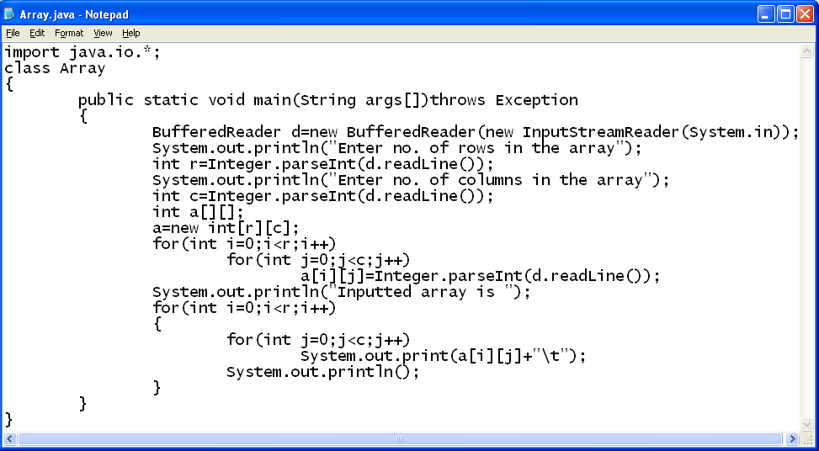
Java Basics
Single Dimensional array Input & Output

Slide 10
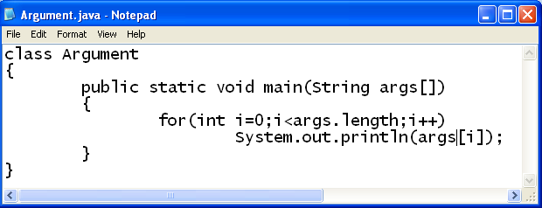
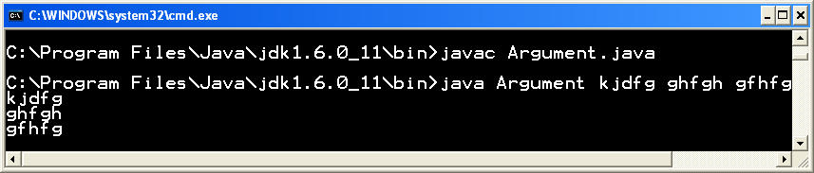
Java Basics
Command Line Arguments
  These are used to take input from command line
  Example:

